Slide 1
Object Detection
A review

Slide 2
Outline
Definition
Overall and In-detail approach
Example with popular deep learning detectors

Slide 3
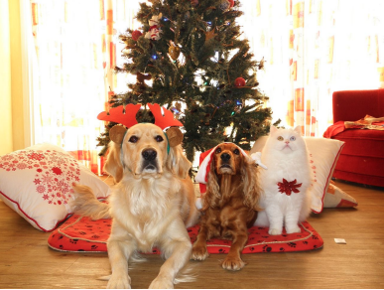
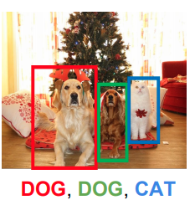
Definition
Is a subtask of Computer Vision
Objective: Localize the object and Classify each instances
Notes:
http://cs231n.stanford.edu/slides/2017/cs231n_2017_lecture11.pdf

Slide 4
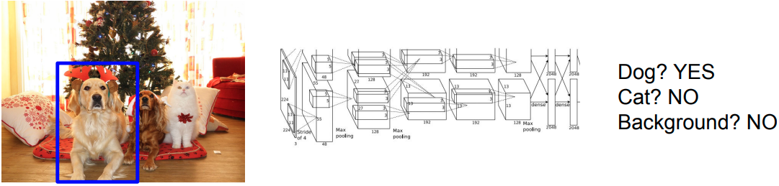
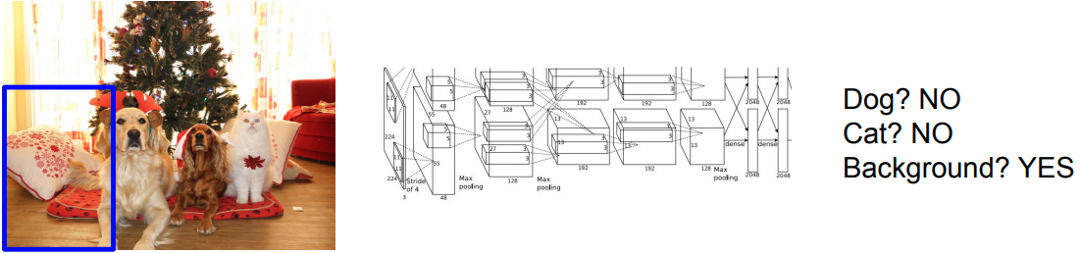
Approach
Common approach in object detection:
Learning Feature Presentation for Image’s PATCH (using Computer Vision Algorithms)
Classify patches as background or objects (using Machine Learning Algorithms)
Notes:
http://cs231n.stanford.edu/slides/2017/cs231n_2017_lecture11.pdf

Slide 5
Approach (cont)
Patch
Feature
Patch
Localization
+
Classification
Input Image
Patch Feature
Patch
Localization
+
Classification
PostProcess
Final
Localization
+
Classification
Patch Feature
Patch
Localization
+
Classification

Slide 6
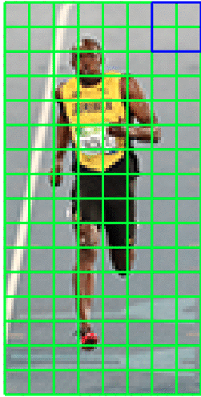

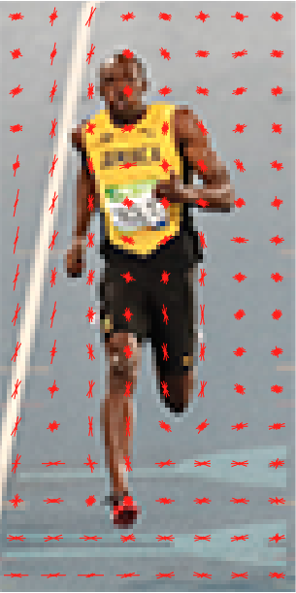
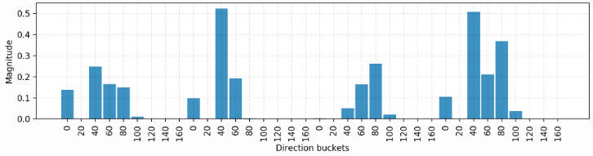
Feature Presentation
Traditional Computer Vision Algorithms (handcrafted feature):
Feature descriptors: SIFT, SURF, HOG, Haar-like
Deep learning (deep feature):
Feature extracted using common CNN: VGG, MobileNet, Resnet
Feature Vector
Histogram of Gradient in Blue Area
Notes:
https://www.pyimagesearch.com/2015/03/23/sliding-windows-for-object-detection-with-python-and-opencv/

Slide 7
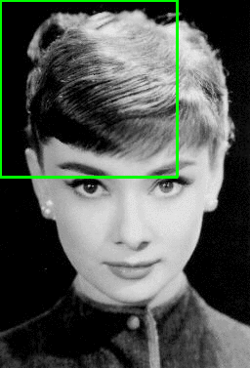
Localization
Conventional: Sliding window
Problems: Too many possible windows (Different scales, Different shape)
Problems: Overlapping output boxes
Notes:
https://towardsdatascience.com/non-maximum-suppression-nms-93ce178e177c

Slide 8

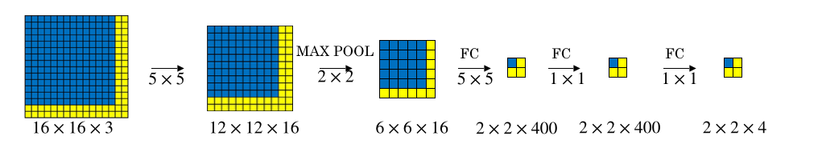
Localization (cont)
To reduce computational overhead of sliding window:
Use CNN
Before: predict each region separately
Now: predict all region at once
Use segmentation algorithm
Selective Search proposes 2000 regions (patches)
Problems:
Object can be big and span multiple
classes
boxes
Notes:
SELECTIVE SEARCH: https://lilianweng.github.io/lil-log/2017/10/29/object-recognition-for-dummies-part-1.html#selective-search

Slide 9


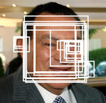
Localization (cont)
Problem: detect “giant” objects
Image Pyramid:
Scale down image to different scales
Detect objects on each scales
Merge different scales
Image Pyramid
Predict each scales
Merge into original size
Notes:
https://kpzhang93.github.io/MTCNN_face_detection_alignment/paper/spl.pdf

Slide 10
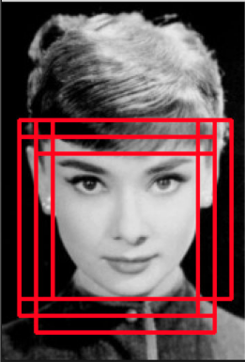
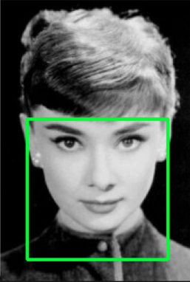
Localization (cont)
To merge overlapping predicted boxes:
Use NMS (Non-Maximum Suppression as follow:
Sort predicted boxes descendingly by confidence scores
Calculate overlap score (IoU) between score
Remove low score overlapped boxes
IoU = area of intersection / area of union
(between 2 boxes)

Slide 11
Classification
Classify patch features of patches into corresponding category using Machine Learning Algorithms
Traditionally: Support Vector Machine (in RCNN network)
Output separable margin between classes
Difficult to train
Neural Network: Softmax + Cross Entropy (in recents deep learning detecto
Soft boundary between classes
Easy to train
Provide probabilistic interpretation

Slide 12
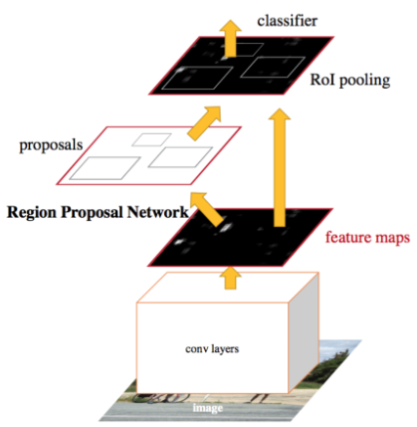
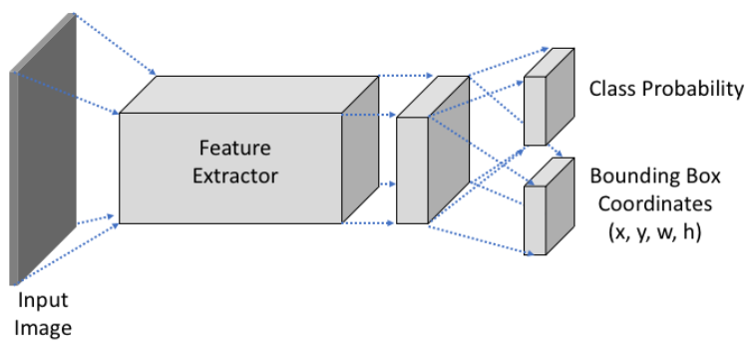
Object Detection in Deep Learning Era
Divided into 2 paradigms
Two Stage Object Detectors
One region proposal model
One regression and classification model
Example includes: RCNN family
Was believed to be more accurate
Single Stage Object Detectors
Predict bounding boxes and classification score in single pass through the network
Faster
More overlapping output
Notes:
https://lilianweng.github.io/lil-log/2018/12/27/object-detection-part-4.html
https://lilianweng.github.io/lil-log/2017/12/31/object-recognition-for-dummies-part-3.html

Slide 13
Object Detection in Deep Learning Era (cont)
Follow conventional procedure:
Learning feature presentation:
Model used to extract feature called Backbone network
Classify and Regress bounding boxes
Classification & Regression Models are called Head networks
Additional Region Proposal Network in Two Stage Object Detectors
Region Proposal
Image
Backbone
Classification
+
Regression

Slide 14
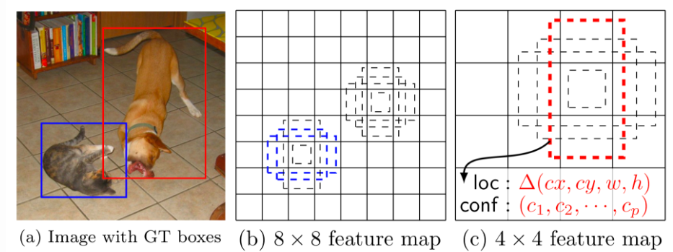
Single Stage Object Detection
In SSD and EfficientDet setup. Model predicts offset of predefined Anchor boxes for every location of the feature map.
Each box has a fixed size and position relative to its corresponding cell.
Anchor box at different level feature map have different receptive fields
Notes:
https://lilianweng.github.io/lil-log/2018/12/27/object-detection-part-4.html

Slide 15
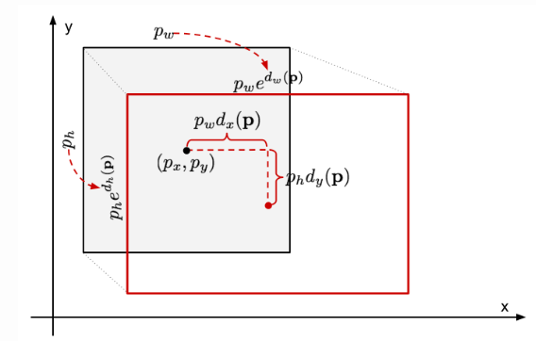
Single Stage Object Detection (cont)
In normal setup, each cell is responsible for 9 anchor boxes:
3 scales: [1, 1.26, 1.58]
3 shapes: (W : H) [1:1, 2:1, 1:2]
Head network classifies each cell and regresses offset to ground truth boxes
Transform (offset and anchor boxes) to coordinates
p(x,y,w,h): anchor x,y,w,h
d(x,y,w,h): offset to learn ([0,1])
g(x,y,w,h): ground truth x,y,w,h
Notes:
https://lilianweng.github.io/lil-log/2017/12/31/object-recognition-for-dummies-part-3.html#bounding-box-regression

Slide 16
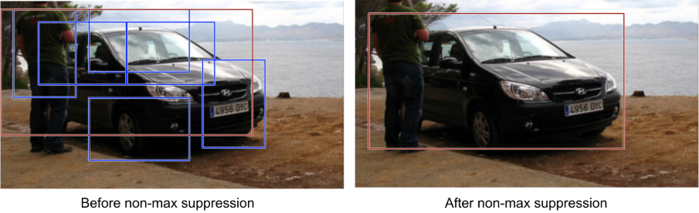
Single Stage Object Detection (cont)
Finally, apply NSM to filter out overlapping boxes
Notes:
https://towardsdatascience.com/non-maximum-suppression-nms-93ce178e177c

Slide 17
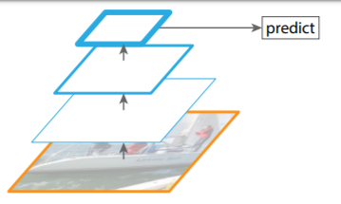
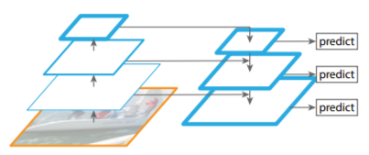
Single Stage Object Detection (cont)
Prediction in last feature map (size ~ 1/(2^7) normal size) has low recall (miss object due to low spatial information)
Instead, predictions are done in multiple feature map of different size
Concatenate infos from higher level (high semantic infos) with lower level (high spatial infos)
Single pass with free multi-scale
Notes:
https://arxiv.org/pdf/1612.03144.pdf

Slide 18
Single Stage Object Detector (cont)
EfficientDet is published at the end of 2019
EfficientDet is recently the most advanced Object Detector, which combines strengths of previous models.
Lightweight backbone
Multi-scale detection
Single forward pass
Advance loss function
Notes:
https://arxiv.org/pdf/1911.09070.pdf

Slide 19
EfficientDet
Single Forward Pass
9 pre-defined anchors
EfficientNet backbone network
Lightweight, scalable model
Bi-directional Feature Pyramid Network (detect multi-scale objects)
Info go 2 ways: from lower level to higher level and vice versa
Increase depth
Focal Loss for classify objects
Address imbalance classes
Decrease weight of easy example while increase weight of hard example
Smooth L1 Loss for regression problem
Post Process with NMS
Notes:
https://arxiv.org/pdf/1911.09070.pdf

Slide 20
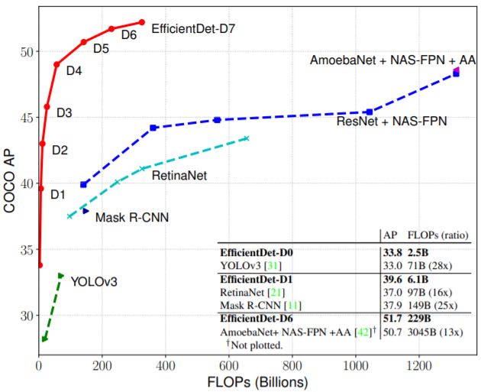
EfficientDet (cont)
Backbone lightweight
4x-9x time smaller than other detectors
2x-4x faster than other detectors
Comparable accuracy
State-of-the-art with EfficientDet-D7
Notes:
https://arxiv.org/pdf/1911.09070.pdf

Slide 21
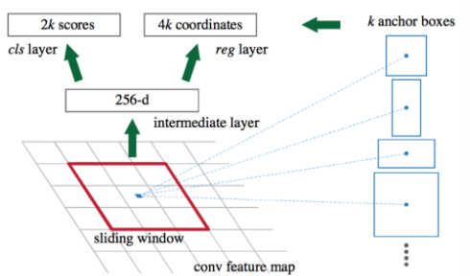
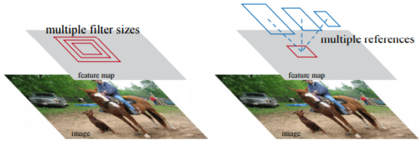
Two Stage Object Detection
Faster RCNN
Backbone network extracts feature maps (more meaningful representation of the input image)
RPN regresses object’s bounding box to predefined anchors (later).
Those Anchors come in different scales and shape to fit different object’s size and shapes
RPN network predicts objectness along regress boxes.
Notes:
https://arxiv.org/pdf/1506.01497.pdf
https://lilianweng.github.io/lil-log/2017/12/31/object-recognition-for-dummies-part-3.html

Slide 22
Two Stage Object Detection (cont)
Faster RCNN:
Roi pooling proposed region to feed into Head networks
ROI pooling intuitively resize proposed region into fixed size (N x N)
Output corresponding classes and Offset (later) to ground truth boxes
Transform (Offset + Anchors) (later) to box’s coordinates
NMS to suppresses overlapping boxes

Slide 23
Thank you for listening

Slide 24
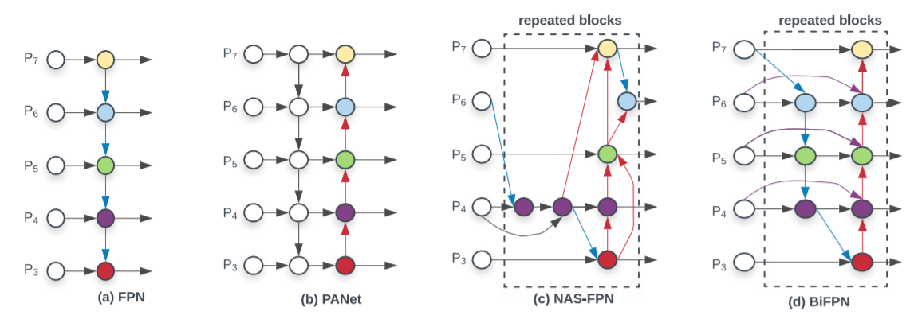
Miscellaneous
Compare different Feature Pyramid Networks

Slide 25
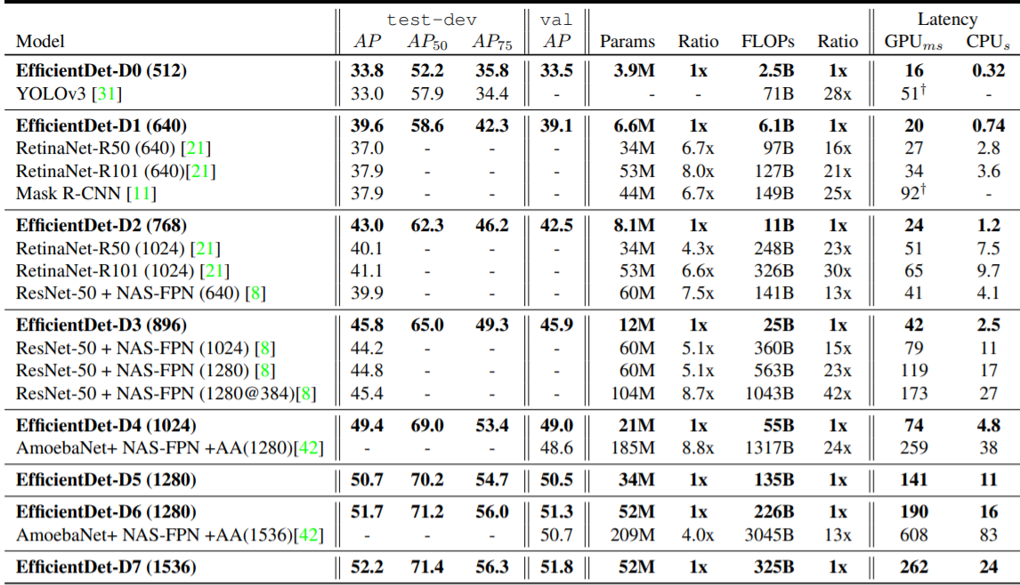
Miscellaneous (cont)
Compare accuracy and speed of EfficientDet vs other detectors (on Titan V GPU)

Slide 26
References
Single Stage: https://lilianweng.github.io/lil-log/2018/12/27/object-detection-part-4.html
Two stage: https://lilianweng.github.io/lil-log/2017/12/31/object-recognition-for-dummies-part-3.html
Faster RCNN: https://arxiv.org/pdf/1506.01497.pdf
Object detection: http://cs231n.stanford.edu/slides/2017/cs231n_2017_lecture11.pdf
HOG detection: https://www.pyimagesearch.com/2015/03/23/sliding-windows-for-object-detection-with-python-and-opencv/
EfficientDet: https://arxiv.org/pdf/1911.09070.pdf
Feature Pyramid Network: https://arxiv.org/pdf/1612.03144.pdf
References Images from various source

